Slide 1

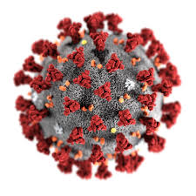

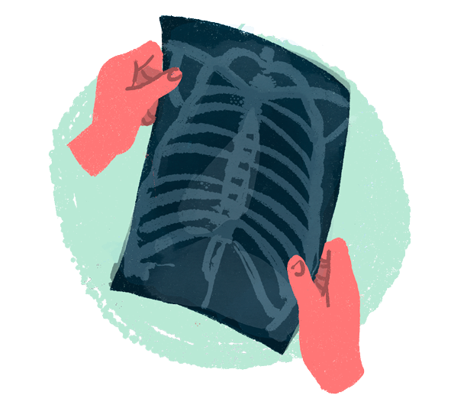
Smart assistant for ease the process of Covid-19 and Pneumonia detection Project ID - 2021_180

Slide 2
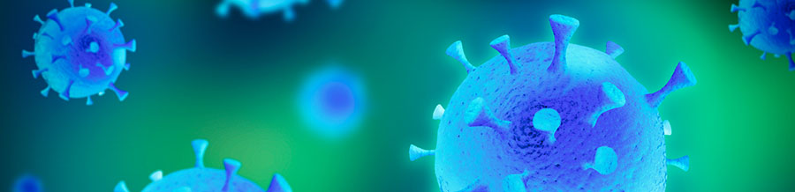








Introduction
Research question
Objectives
Outline
System Diagram
Member- 1
Member- 2
Member- 3
Member- 4

Slide 3

Introduction

Slide 4
Research question

Slide 5

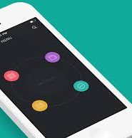
Accuracy level of the applications are low. And it is time consuming
PCR test is the only covid-19 detection test in developing coutries
Number of Covid-19 patients increase day by day
Patients should direct to medical reccomendations when they are tested positive for pneumonia/covid-19
It is very useful if we can develop an application to detect covid-19/pneumonia very fastly and accuratly

Slide 6
Objectives

Slide 7

Smart assistant to identify Covid-19 and pneumonia
Accurate diagnosis and predict risk level of Covid-19 or Pneumonia by using symptoms
Accurate diagnosis of Covid-19 using chest CT Scan images
Identify whether they are suffering from Covid-19 or Pneumonia by using Chest X-ray images.
Gather information about patient's health history, bad habits then analyze it and give doctor recommendation.

Slide 8
System Overview diagram

Slide 9
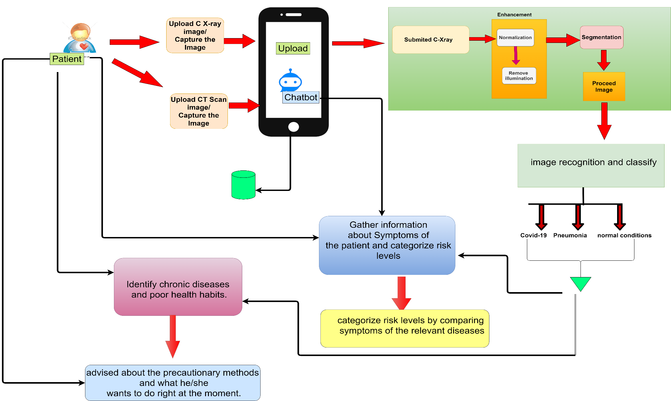
System overview diagram

Slide 10

IT18115130 SENEVIRATHNE K.D.A Information Technology
IT18115130 Senevirathne K.D.A 2021-180

Slide 11
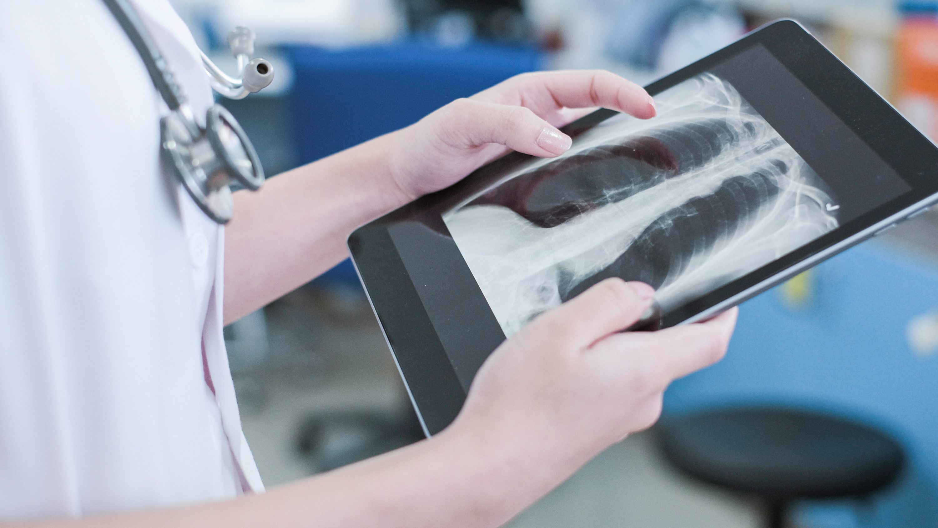
Smart assistant to detect Covid-19 and Pneumonia by using Chest X-ray images

Slide 12
Introduction
IT18115130 Senevirathne K.D.A 2021-201

Slide 13
Why CHEST X-RAY ?
Covid-19 infected patients have shown that they are mostly affected by lung diseases.
RT-PCR test takes at least more than 12 hours
RT-PCR test requires specific material equipment
A cheap method compared to PCR tests or CT Scan tests

Slide 14
Research Gap
Mobile App | App 1 [Pneumonia] | App 2 [x-ray classifier] | App 3 [Corona check] | Proposed app
capture Chest X-ray image by using phone camera | ✓ | ✓ | × | ✓
Upload Chest X-ray image from phone gallery | × | × | × | ✓
Identify Covid-19 | × | × | × | ✓
Identify Pneumonia | ✓ | ✓ | ✓ | ✓
Accuracy level | low | low | low | more accurate result

Slide 15
Identify covid-19 infected as soon as possible
Patient must wait for long time to get their PCR test report
Need to be detect Pneumonia infected patients in an early stage
Research Question?

Slide 16
Specific Objectives
To develop a model for image acquisition
Image enhancement to process the image according to the specific application.
Develop a useable method to give a result whether he or she suffering from Covid-19 or Pneumonia or not
Machine learning techniques are used for identify the chest x-ray type by using an uploaded image.
Image segmentation partition image into meaningful regions

Slide 17



Sub Objectives
Giving suggestions to the users to go to the questioners provide by our proposed app
Uploading Chest X-ray image in a user-friendly manner
Show the test result in an attractive way
User can upload or capture the chest X-ray image
To develop user-friendly analyser for both teenagers and adults

Slide 18
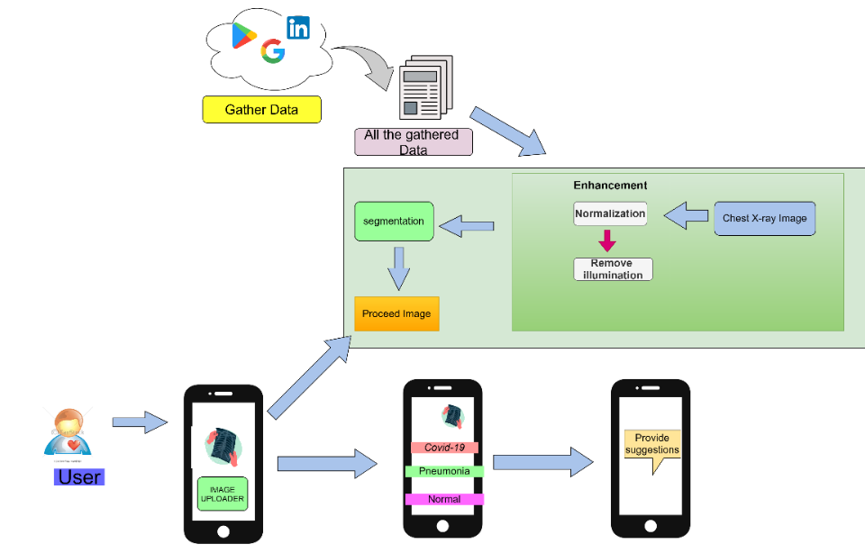
Research Methodology

Slide 19
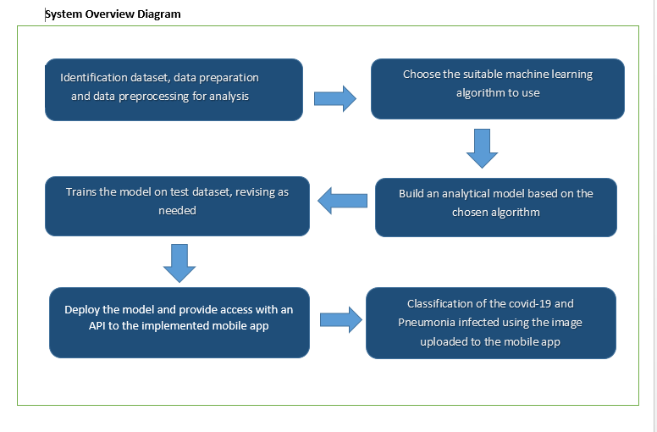
Research Methodology

Slide 20





Technologies
Programming languages
Python
Java Script
Algorithm
CNN
Technologies
Android Studio
Firebase
TensorFlow
Visual Paradigm
Proto.io
GitHub

Slide 21
Requirements
Functional Requirements
System should use for teenagers as well as adults
Display the user’s awareness level
It should be easily understandable to everyone
There should be a proper way to upload or capture the Chest X-ray image
User should have a Chest X-ray image
Non-functional requirements
Usability –anyone can easily access the app
Availability – users can access this anywhere at any time
Performance – fast uploading when it's opening
Reliability - Always show the accuracy result to the user

Slide 22
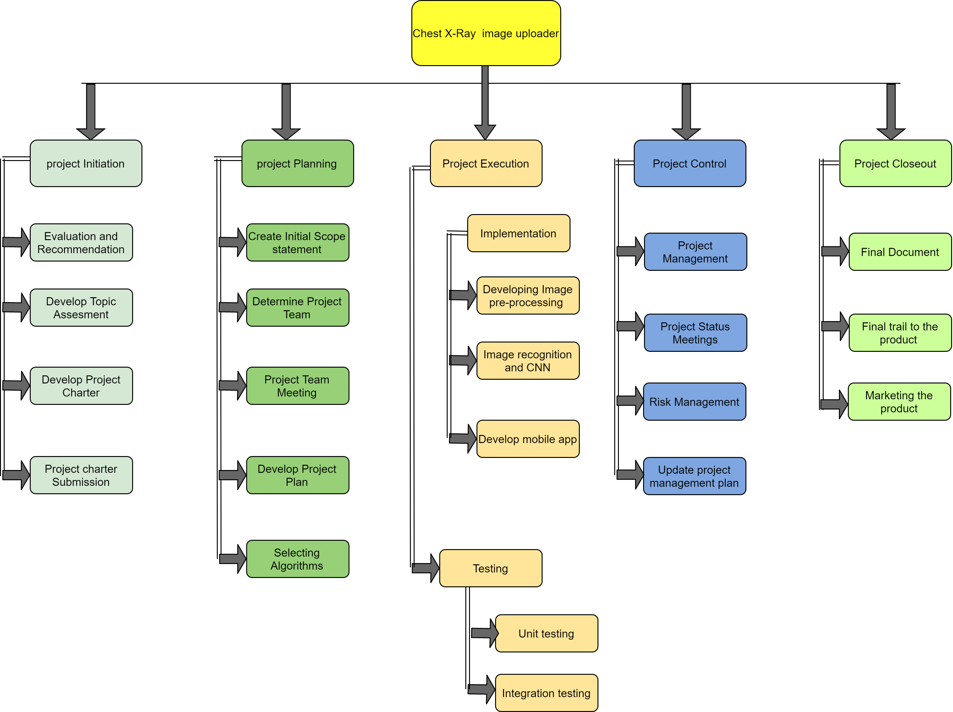
Work breakdown Structure

Slide 23
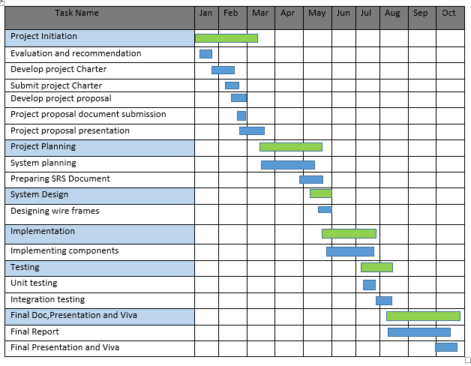
Gantt Chart

Slide 24

SUPPORTIVE INFORMATIONS

Slide 25

COMMERCIALIZATION
This app will be realized at the end of this year 2021
Initial app contains four main functions
Promote this app by using social media

Slide 26
Budget
Item | Price (Rs.)
Sample X-ray | 2500
Documentation | 3000
Printing photocopies | 2000
Total | 7500

Slide 27
References
[1] Tabik, S.;A. Gómez-Ríos, J. L. Martín-Rodríguez, I. Sevillano-García, M. Rey-Area, D. Charte,, "COVIDGR Dataset and COVID-SDNet Methodology for Predicting COVID-19 Based on Chest X-Ray Images," IEEE JOURNAL OF BIOMEDICAL AND HEALTH INFORMATICS,, 2020.
[2] H. Sharma, J. Sethia Jain, P. Bansa and S. Gupta, “"Feature Extraction and Classification of Chest X-Ray Image using CNN to detect Pneumonia",” 2020.
[3] Md. Mehed Hasan, Mir Md. Jahangir Kabir, Md. Rakibul Haque, Mohiuddin Ahmed, "A Combined Approach Using Image Processing and Deep learning to detect Pneumonia from chest X-rays," IEEE, 2019.
[9] A. Sharma, D. Raju and S. Ranjan, "Detection of Pneumonia clouds in Chest X-ray using Image processing approach," 2017.
[10] Chest X-ray images Available online https://www.kaggle.com/prashant268/chest-xray-covid19-pneumonia

Slide 28
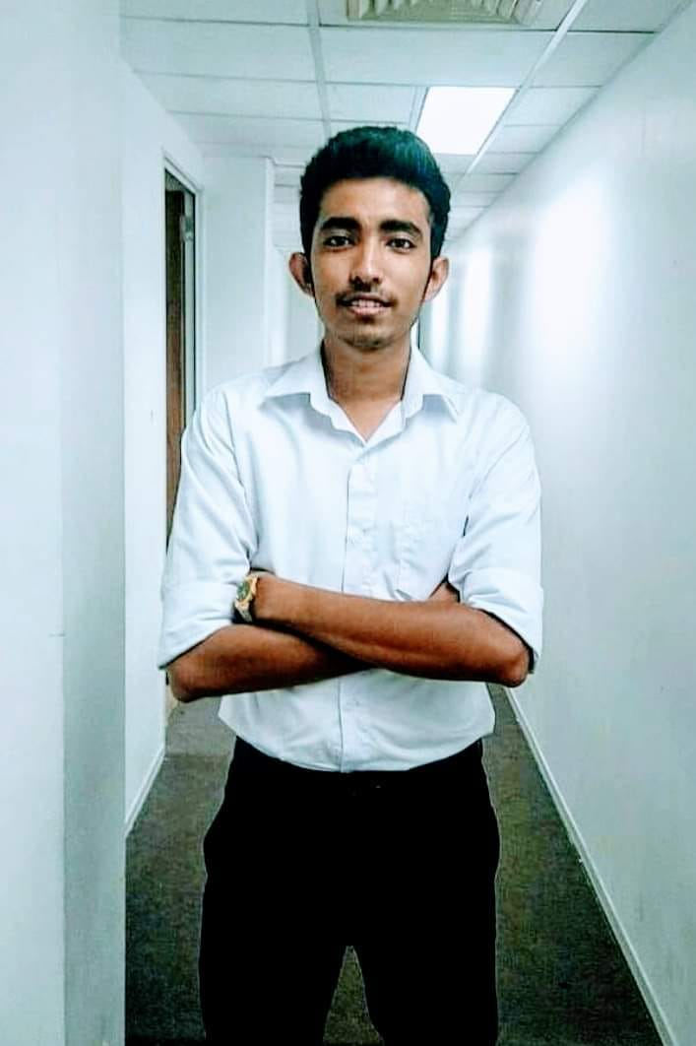
IT18125962 NIMANTHA W.A.R Information Technology
IT18125962 Nimantha W.A.R 2021-180

Slide 29
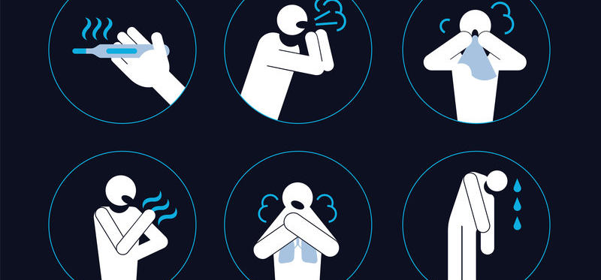
accurate diagnosis and predict risk level using symptoms

Slide 30
Introduction

Slide 31
Research Gap
There are many mobile applications for detect pneumonia and few for Covid-19 using AI. most of them have detect x-ray issues only. Two mobile apps found detect covid-19 using symptoms . But there are not properly working. There is a remarkable gap.
Mobile App | App 1 (covid AI)[5] | App 2(igedla)[6] | Proposed app
Predict risk level | × | × | ✓
Use AI for Detection | ✓ | × | ✓
Identify Covid-19 | ✓ | ✓ | ✓
Identify Pneumonia | × | × | ✓
Accuracy level | low | low | more accurate result

Slide 32
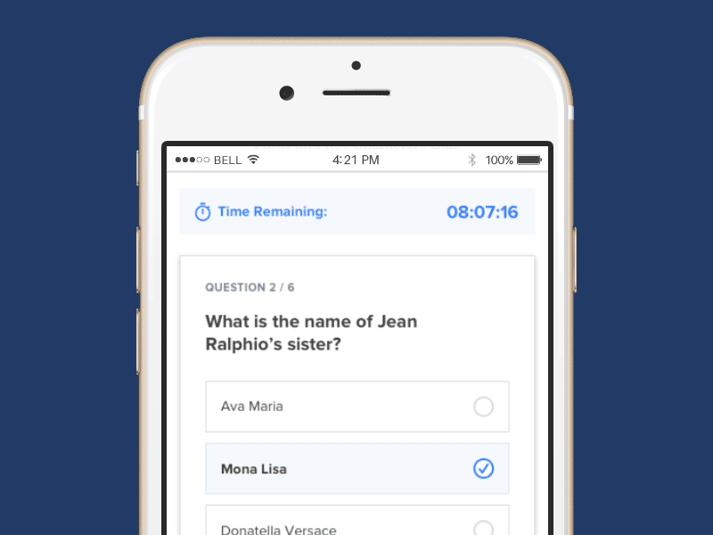

Specific Objectives
Gather Information
Symptoms
Age
Gender
Facilities
Detect Covid-19 and Pneumonia
Predict Risk level
​
Analyze

Slide 33
Sub Objectives
To develop user-friendly analyser for both teenagers and adults
Increase accuracy trained model
Show Results Attractively
User can select symptoms in multiple selector window
Giving suggestions to the users to go to the questioners provide by our proposed app

Slide 34
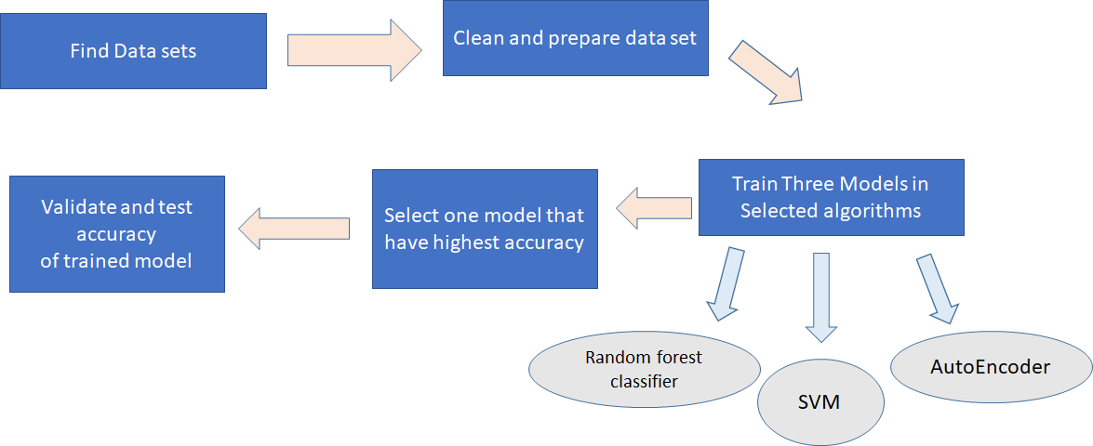
Research Methodology

Slide 35
Why Train 3 Algorithms ?
Selected three algorithms (SVM, Autoencoder ,random forest classifier)show high accuracy than other algorithm that disease prediction researches.
Disease | Algorithm | Accuracy Level
[2]tuberculosis | SVM | 98.7%.
[3]Tuberculosis | SVM | 96.68%
[1] tuberculosis and pneumonia prediction | Random forest classifier | 97.64%
[4] Fatality Prediction of COVID-19 | Autoencoder | 97%

Slide 36
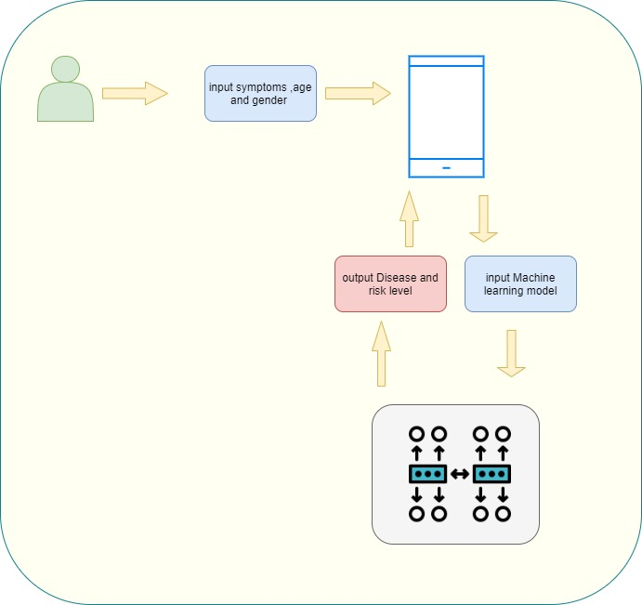
System Diagram

Slide 37



Technologies, Algorithms , Programming Languages
Technology
TensorFlow
Google Calab
Android Studio
GitHub
Algorithms
Random forest
Auto-encoder
Support Vector Machine (SVM)
Programming language
Python
Java Script

Slide 38
Requirements
System
Collection data using Questionnaire and form.
Give high accuracy results.
Get large data set to analyze.
Personnel
User must enter the real symptoms, Gender and Age .
Software Specification
Usability- every adults teenagers can use this application.
Availability – application must available 24*7.
Reliability- system should be protect details and results should be accurate.

Slide 39
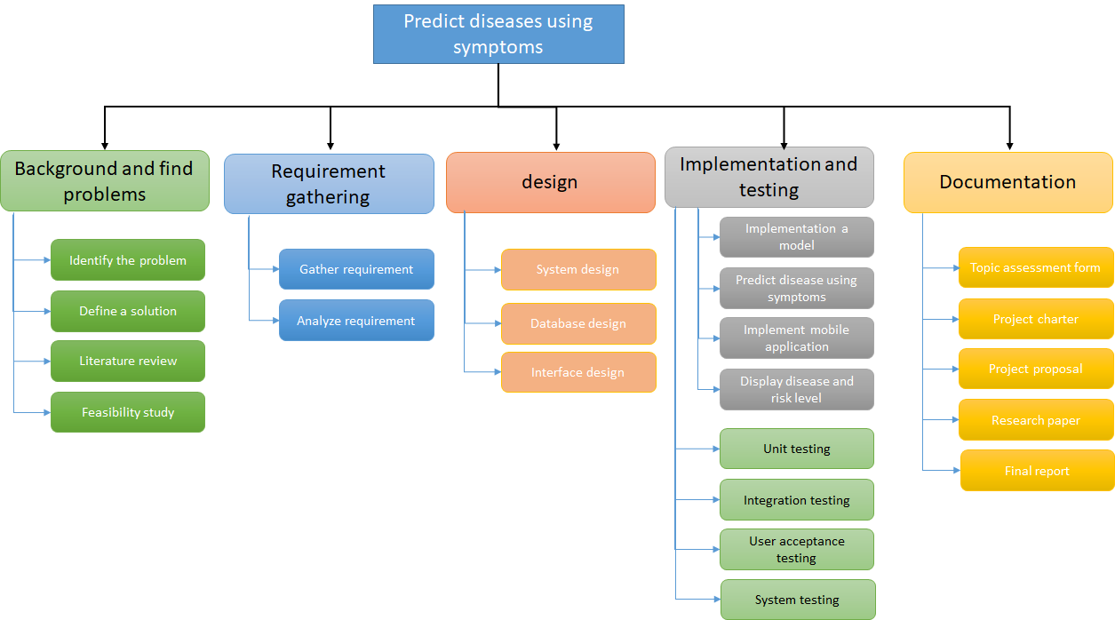
Work breakdown Structure(WBS)

Slide 40
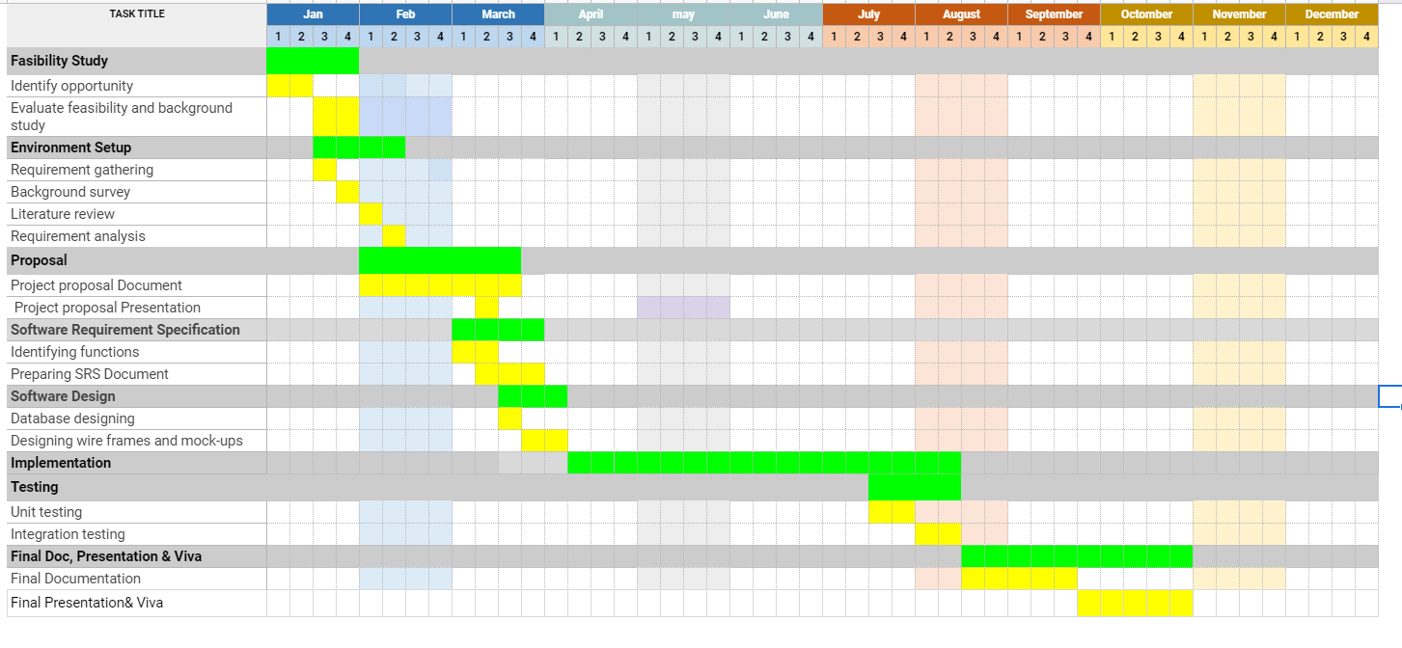
Gantt Chart

Slide 41

Commercialization
What Are We Selling?
We provide accurate covid-19 and pneumonia detection and prediction risk level methods to world and helping to improving health care system by identifying diseases and save many human Lifes.
Teach peoples about this app through seminars and you tube video series
Use social media and web sites to promote this app.

Slide 42
Budget
Item | Total Cost
Document Print out | 2500/-
Photo Copy | 1000/-
Other | 1000/-
total | 4500/-

Slide 43
References
[1] Aiyesha Sadiya, Anusha V Illur, Aekhata Nanda, Eshwar Rao, Vidyashree K P, Mansoor Ahmed (2019). Differential Diagnosis of Tuberculosis and Pneumonia using Machine Learning
[2] T, A., Natarajan, S., & Murthy, K. N. B. (2011). A Data Mining Approach to the Diagnosis of Tuberculosis by Cascading Clustering and Classification. Journal of Computing, 3(4).
[3] Yahiaoui, A., Er, O., & Yumusak, N. (2017). A new method of automatic recognition for tuberculosis disease diagnosis using support vector machines. Biomedical Research, 28(9), 4208– 4212.
[4] Individual-Level Fatality Prediction of COVID-19 Patients Using AI Methods (2019). Available online at https://www.frontiersin.org/articles/10.3389/fpubh.2020.587937/full#B8
[5]https://apps.apple.com/lk/app/covid-ai/id1505887668
[6]https://apps.apple.com/lk/app/igedla/id1534336584

Slide 44

IT18121698 DIAS M.H.V Information Technology
IT18121698 Dias M.H.V 2021-180

Slide 45
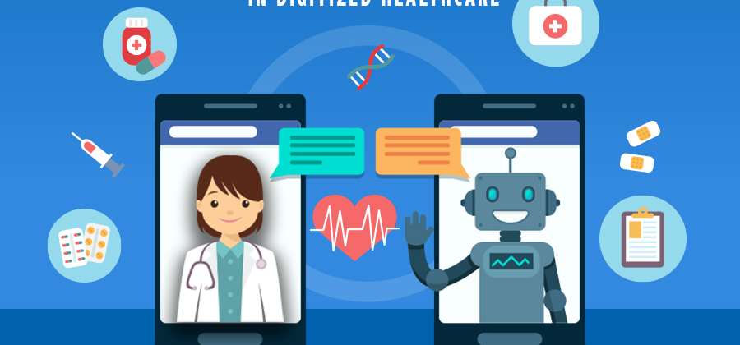
Medical Chatbot and doctor recommendation

Slide 46
Introduction

Slide 47

Why Medical Chatbot?
Medical chatbot can gather information about patient's real time health condition.
Patient's severity level will be analyze using gathered information.
Overall result will not only depend on x-ray/CT scan classification but also depends on patient's health history and chronic diseases.
Maximize the accuracy level of the final output.

Slide 48

Research Gap
Most of the existing applications do not have the facility of
Interact with the patient and gather health information about
chronic diseases
surgeries
Pregnancy
bad health habits etc.
checking the severity level based on gathered information.
Gather information about patient’s current health condition.
giving doctor recommendation, health tips according to the severity level of the patient.

Slide 49

Application | Pneumonia detection | Covid-19 detection | Ask patient’s bad health habits | Ask patient’s health history | Doctor recommendation/health precautionary methods | Gives information about the disease
Mobile App A (Pneumonia)
Mobile App B (Corona check)
Mobile App C (x-ray classifier)
Smart assistant to ease the process of Covid-19 and Pneumonia Detection

Slide 50
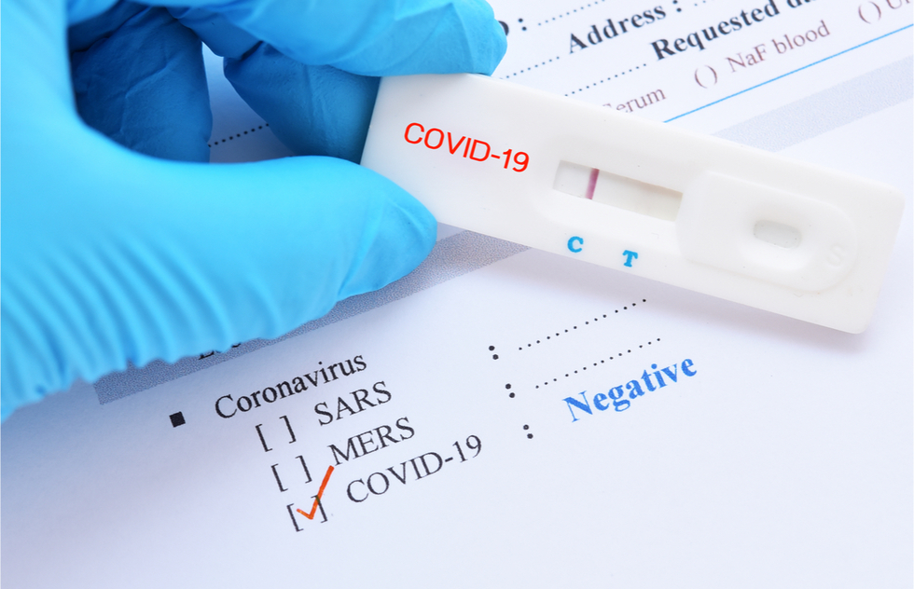
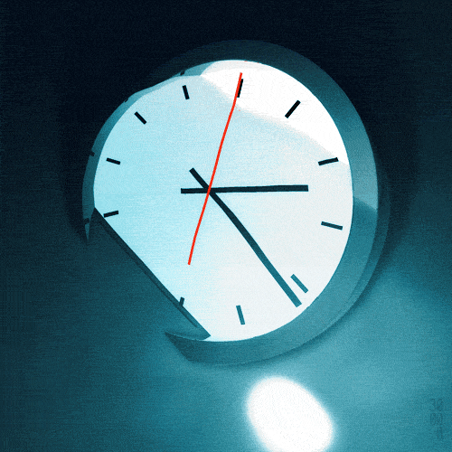
Research Problem
Patient has to wait for a long period to get the results of PCR tests.
Accuracy of the output is very low since those applications do not consider about the patient's chronic diseases and other health information.

Slide 51
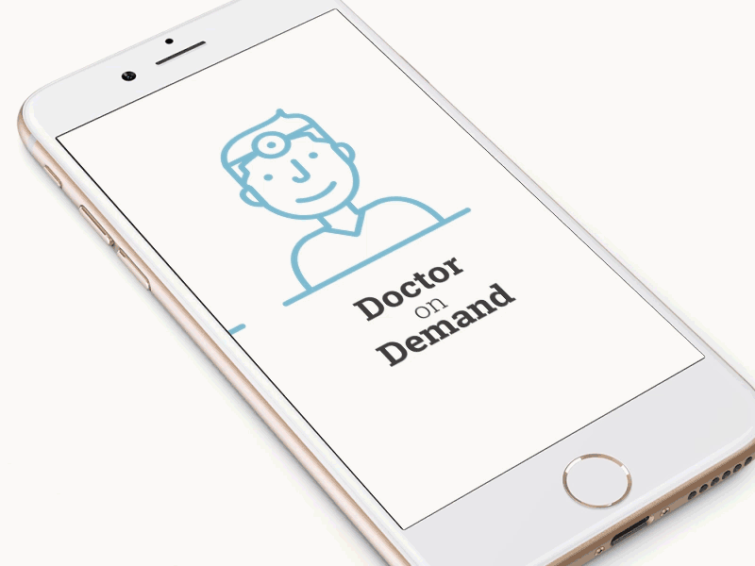
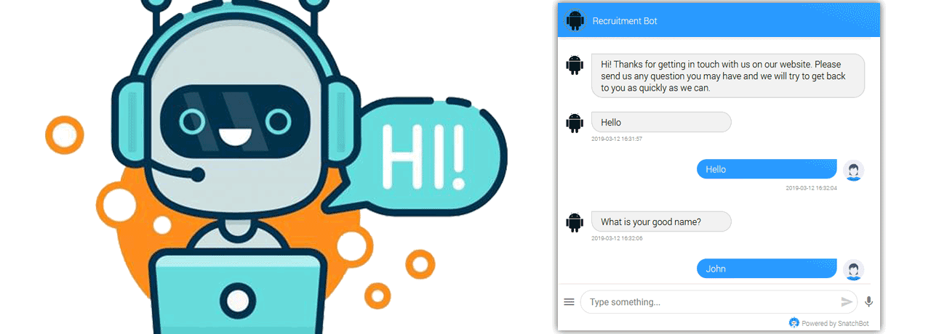



Specific Objectives
Gather Information
Chronic diseases
Bad health habits
Pregnancy
Surgeries
Facilitate
Doctor Recommendation
Health tips
Precautionary methods
Analyze

Slide 52
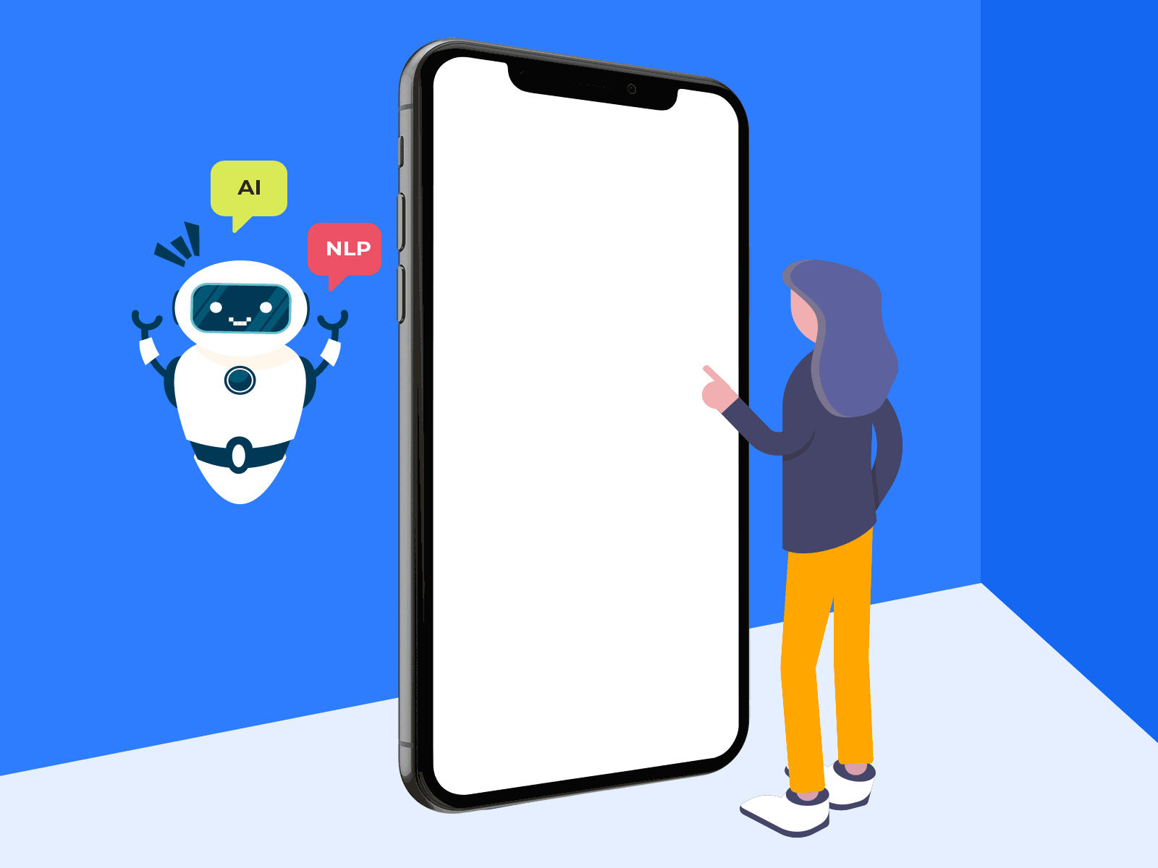
Sub Objectives
Provide accurate health precautianry methods,health tips and medical reccomendation according to the sevarity level
User friendly mobile app to gather information.
Give accurate results
User can explain his/her health condition using a natural language
Develop the chatbot to use by people in every age and different knowledge.

Slide 53

Research Methodology
Data Gethering
Clean, prepare and preparation for machine learning
Trains the model
Severity level identification and doctor recommendation
Classifiers

Slide 54
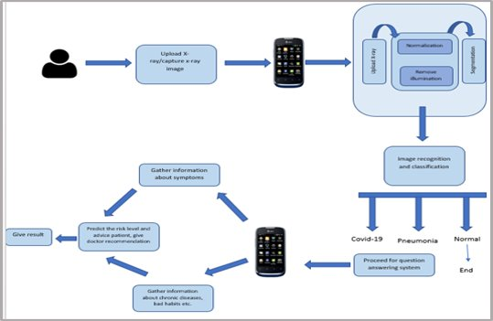
System Diagram

Slide 55

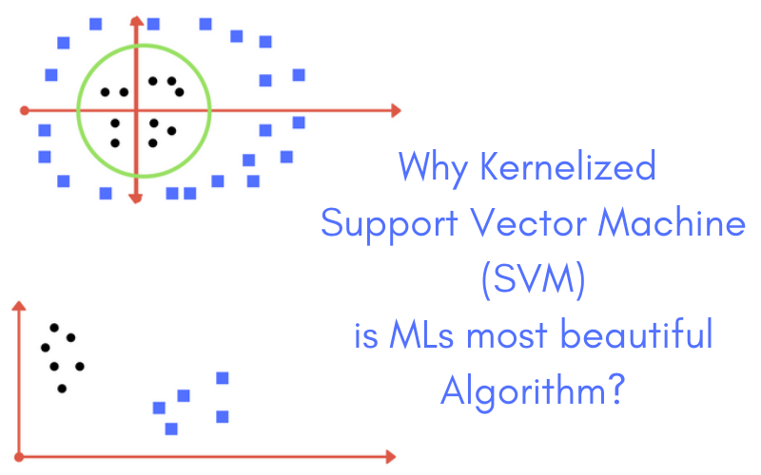



Technologies and Algorithms
Technologies
Android Studio
Github
TensorFlow
Google colab
Algorithms
KNN
SVM
HAN

Slide 56
Requirements
System Requirements
Guide user from the starting point to end point
Easy to use by people in any age group.
Gather correct information for anlysis.
Give accurate results.
…...........
Personal
User should clearly communicate with the chatbot feature.
User should give true information regarding his/her health problems.
Software Specification
Usability: App should be user friendly for any age group.
Availability: App should be use any time anywhere.
Performance: Answering time of chatbot should be reduce.
Reliability: Reults should be accurate and user's personal data should be protected.

Slide 57
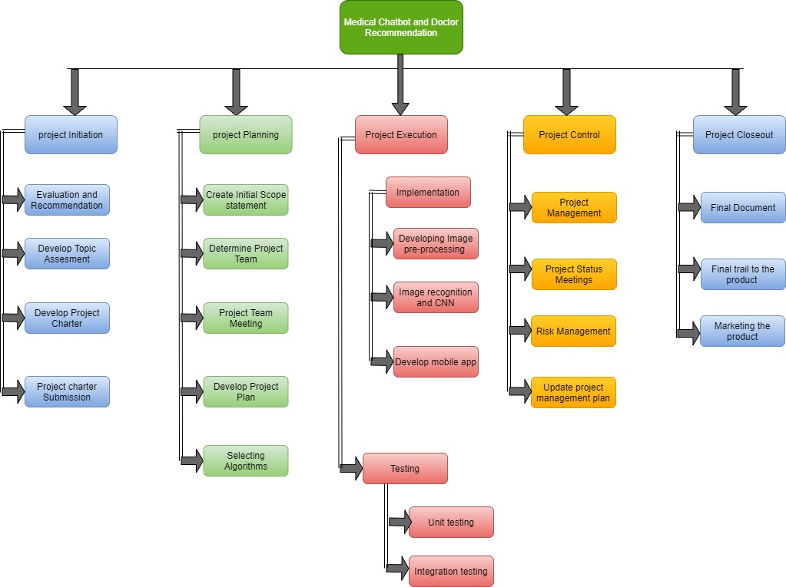
Work Breakdown Structure (WBS)

Slide 58
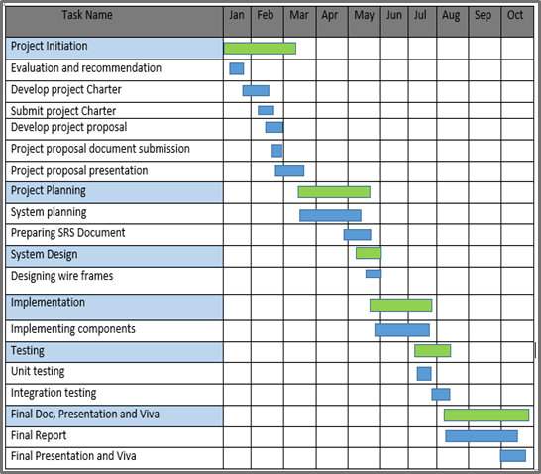
Gantt Chart

Slide 59

Supportive Information
COMMERCIALIZATION
This app will ease the process of identifying covid-19 and pneumonia within a small time period.
This app will be realease at the end of this year 2021
Promoting the app will be done through social media
App contains four main functionalities and accuracy of the output will be maximize in each level.

Slide 60
Budget
Item | Price (Rs.)
Sample X-ray | 2500
Documentation | 3000
Printing photocopies | 2000
Total | 7500

Slide 61
Referrences
[1] SunP, LuX, XuC, et al. Understanding of COVID-19 based on current evidence. J Med Virol. 2020;92(6):548–551. [Crossref], [Web of Science ®], [Google Scholar]
[2]SheridanC. Coronavirus and the race to distribute reliable diagnostics. Nat Biotechnol. 2020;38(4):382–384. [Crossref], [Web of Science ®], [Google Scholar]
[3] Abu Shawar, B.A., Atwell, E. and Roberts, A. (2005) FAQchat as in Information Retrieval system. In: Human Language Technologies as a Challenge for Computer Science and Linguistics: Proceedings of the 2nd Language and Technology Conference. 2nd Language & Technology Conference, April 21-23, 2005, Poznań , Poland.Poznań : Wydawnictwo Poznań skie: with co-operation of Fundacja Uniwersytetu im. A. Mickiewicza, pp. 274-278. ISBN 9788371773419.

Slide 62

IT18114836 Akalanka B.A Information Technology
IT18114836 Akalanka B.A 2021-180

Slide 63
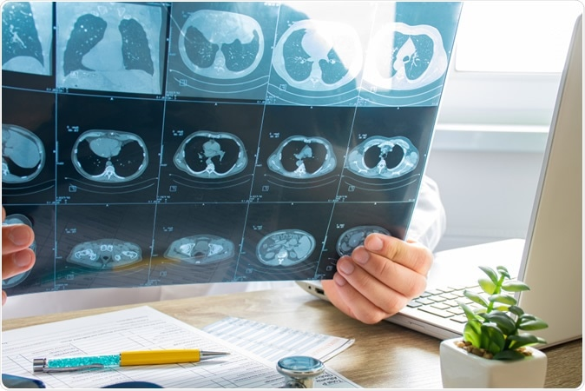
Accurate diagnosis of Covid-19 using Chest CT Scan images

Slide 64
Introduction

Slide 65
Why CT Scan images?
People go undiagnosed with COVID-19 in their early stages due to deficiency of testing equipments.
It takes a long time to get the results from PCR tests
CT-scan could be used to detect COVID-19 because it is more sensitive to viral diagnosis than PCR.
To maximize the accuracy level of the final report we suppose to identify covid-19 using a CT scan images.

Slide 66
Research Gap
 | Research 1 [1] | Research 2 [2] | Research 3 [3] | Proposed app
Develop a mobile app for upload CT scan image and detect Covid-19 | × | × | × | ✓
Image enhancement for speed up the image preprocessing | × | × | × | ✓
Capture a Chest CT scan image by using phone camera | × | × | × | ✓
Upload a pre captured Chest CT scan image | ✓ | ✓ | ✓ | ✓
Accuracy level of the results | low | low | low | more accurate result

Slide 67
Specific Objectives
To develop a model for image segmentation.
The image of the chest CT scan will be analyzed and objects in the image will be separated. The aim of this objective is to separate the important parts from the background of the image.
To develop a model for image acquisition and enhancement.
The uploaded image of the chest CT scan will be analyzed and prepared for segmentation. Various filters and tools are used for removing noises, change contrast, brightness and also other properties of the entire image or part of the image.
To develop a mobile application.
The aim of this objective is to develop the mobile application. The mobile application is used for taking photos of a chest CT scan and upload it to the cloud-based AI model for analyzing.
To develop a model for recognizing the Covid-19 infected chest CT scan images using Machine Learning techniques.
The AI model is developed with machine learning techniques to analyze and identify hidden patterns and relationships between the uploaded image and the trained data set of the AI model.

Slide 68
Sub Objectives
Develop the system without any major crashes or errors.
Uploading Chest CT scan image in a user-friendly manner
Show the test result in an attractive way
Provide results with a high level of accuracy
Give the results to the user as soon as possible

Slide 69
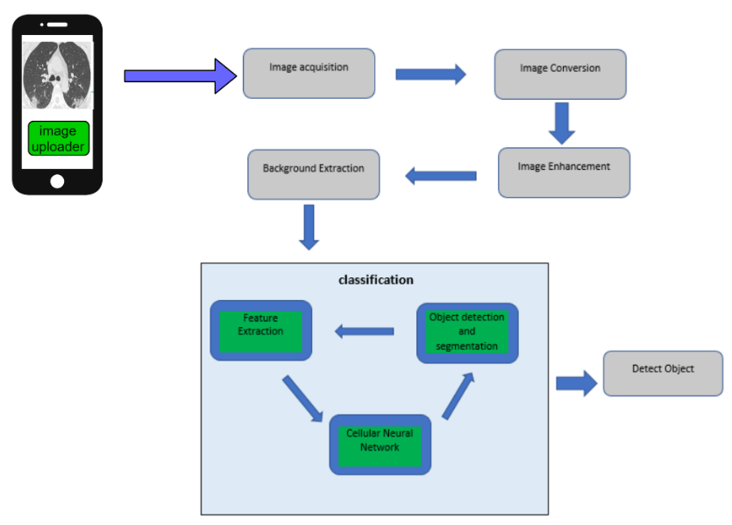
Research Methodology

Slide 70



Technologies and Algorithms
Technologies
Android Studio
Firebase
TensorFlow
Visual Paradigm
Proto.io
GitHub
Programming Languages
Python
Java Script
Algorithms
CNN

Slide 71
Requirements
Functional Requirements
Manage CT scan images
Identify covid-19 infected CT scan images from uploaded CT scan images
Performance requirements
The system should support more users at a time.
The system should provide 24x7 service.
The system shall not experience with any major crashes or errors.
Delivery requirement
The system should be developed within one year of period.
The system should be developed and delivered as a single package to the public.
Implementation requirement
The system will be developed using image processing techniques, AI techniques and mobile application development techniques
Efficiency Requirement
The system should identify 95% correctly using details which are given by the user as inputs to improve the accuracy
System should response within a short time period
Usability Requirements
The system should allow the user to access using mobile devices.
System can be used by any user without a prior knowledge.
Portability requirement
User must be able to access the application through any mobile device

Slide 72
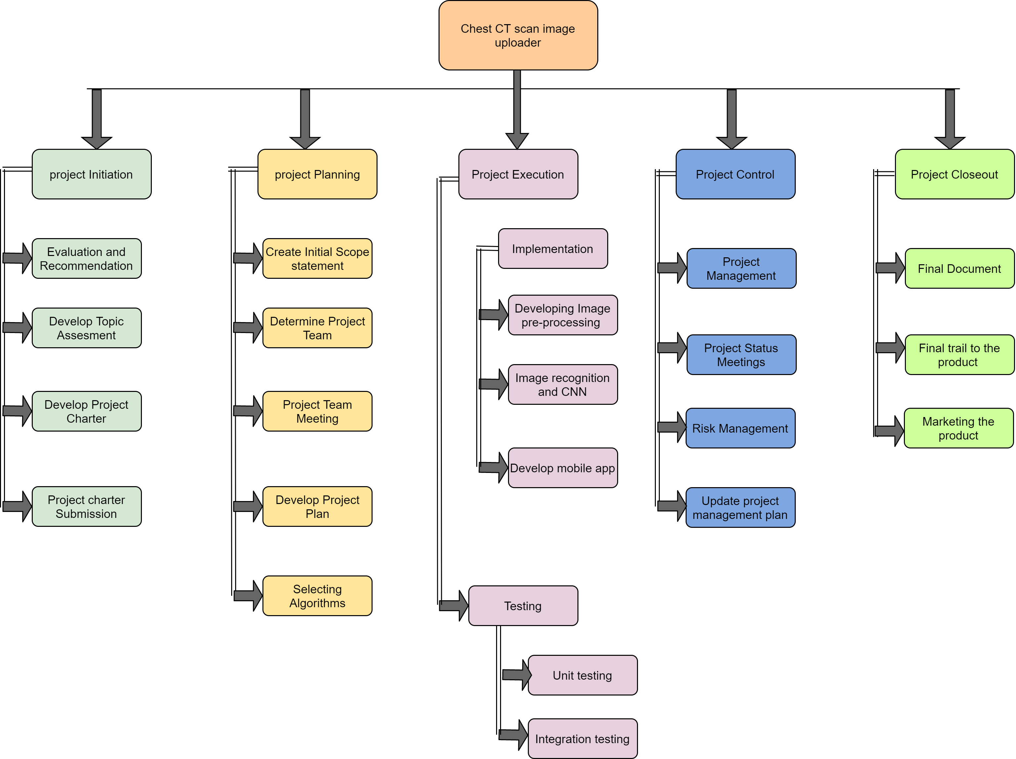
Work breakdown Structure

Slide 73
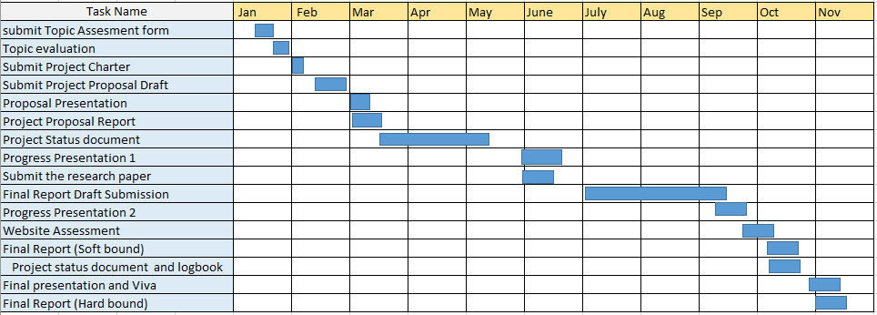
Gantt Chart

Slide 74
Budget
Item | Price (Rs.)
Sample CT image | 5000
Documentation | 3000
Printing photocopies | 2000
Total | 10000

Slide 75
COMMERCIALIZATION
The app will be released on the end of 2021
Initial release contain 4 main functions .
App will be published to google play .
Initial app commercialization by Website

Slide 76
References
[1] Xuelin Qian, Student Member, IEEE, Huazhu Fu, Senior Member, IEEE, Weiya Shi, Tao Chen, Member, IEEE, Yanwei Fu , Member, IEEE, Fei Shan ,and Xiangyang Xue , Member, IEEE, "M3Lung-Sys: A Deep Learning System for Multi-Class Lung Pneumonia Screening From CT Imaging," IEEE, 2020.
[2] Naufal Hilmizen, Alhadi Bustamam, Devvi Sarwinda, "The Multimodal Deep Learning for Diagnosing COVID-19 Pneumonia from Chest CTScan and X-Ray Images," IEEE, 2020.
[3] Sertan Serte, Ali Serener, "Discerning COVID-19 from mycoplasma and viral pneumonia on CT images via deep learning," IEEE, 2020.

Slide 77

THANK YOU

Slide 78

Any Questions?

